Slide 1

Mimoune Djouallah (mim)
Planner
Xer reader
Blogger Datamonkey.com
Australian whole sales Electricity Market
You can download the reports and sample data here
LinkedIn

Slide 2
PowerBI as an integration tool in Project Controls
Agenda
Why PowerBI is a great Option
Cost , Schedule and Quantity integration is a hard problem
Star Schema
Demo
Time to Upgrade to the Service
Further Reading

Slide 3
Cost, Schedule and Quantity Integration is a hard Problem
It is not a technical problem but rather an organisational Problem
One approach instead of trying to change how different people works, Planner, cost controller, Quantity surveyors , maybe the solution is not stop trying but rather find common codes that match different system
Data professional have already solved the same problems we are trying to solve
Data Modelling is perfect for this scenario

Slide 4
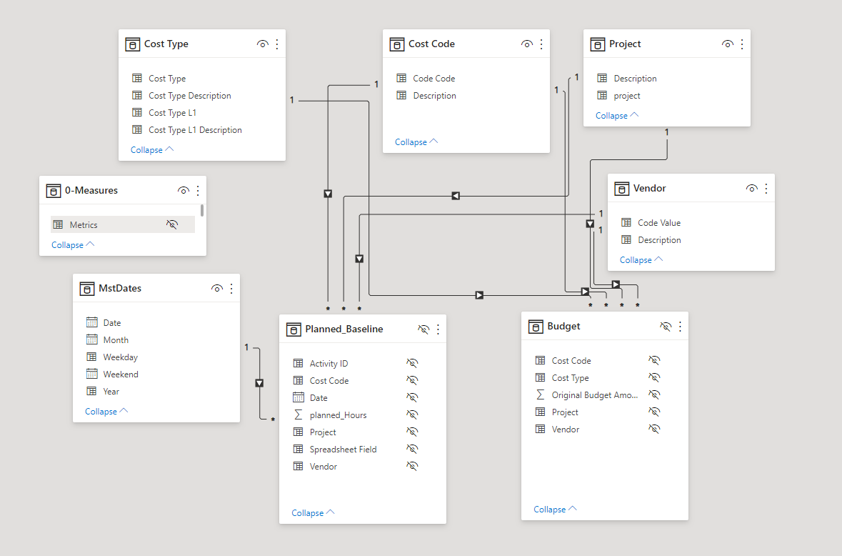
Data Modelling

Slide 5
Data Modelling is not new
There are a lot of tools in the Market for Data Modelling
If you work with SQL Server/Access, probably you have done it before
BigQuery/Data Studio due to the price range is may be interesting in some cases
But if you are a project Controls Professional PowerBI is really the obvious Option

Slide 6
Why PowerBI is the obvious option
A huge community, you will get help if you ask a Question.
Pricing that scale from 0 to +5000 $/Month ( I used PowerBI for free for 4 years, paid nothing in license)
Extremely Powerful Database
Maybe the best Data modelling in the market
PowerQuery for Data preparation ( something has to read those Excel files)
having PowerBI skills in a CV is something that employers will appreciate
Microsoft is investing a lot of resources in improving the Product

Slide 7
Demo of a Simple Report
A simple Data Model
Three System : GL Transaction, Primavera Baseline, Project Budget
Implementing OBS using Row Level Security

Slide 8
Time to Upgrade to PowerBI service
PowerBI Desktop is free, if all you need is just sharing pdf or Static Excel reports, you don’t need to pay anything.
Excel 2013+ has PowerQuery and the Data Model, maybe it is a better option ?
You can share pbix files, but the desktop has no View layout, and you will be back to Excel hell, multiple version of the truth.
For personal development, you can pay for a personal domain name and use it to register in PowerBI service, Personally I use Google Domains, it count around 20$/Year, still no sharing , I like to keep my personal stuff separated from Work.
Another option, if you want to get fired from your job, you can always use Publish to web, it is free, but anyone on the internet can see your data

Slide 9
Some Public reports
Completion Skyline template
Read an SQLite Primavera Database
Power generation in Australia

Slide 10
Further reading
Free resources list
Power BI guidance documentation
Row Level Security

